Slide 1
CLIENT SERVER BASED LIVE MEETING

Slide 2

VISION
This project is mainly developed for the communication of Employees of organization located at different locations.
The project entitled “Live Meeting” set of platform for the project leaders and administrator to send messages to keep constant interaction with the programmers.
The administrator can sit at his system and communicate with the project leaders, programmers and can also maintain the login time, logout time.
He can chat about the project going on with both the programmers and project leaders. This project also maintains offline messages.
The project leader gives the instant report about the project to the administrator.
Whenever user logs-in into the system then login time is recorded in the administrator’s system automatically. The administrator can scan the present online system IP Address and send the messages to single programmer ,set of programmers, project leader or Set of project leaders or all the employees where he/ she is present.

Slide 3
PROBLEM IDENTIFICATIONS
The existing system is manual system.
Needs to be converted into automated system.
Less Security.
No proper coordination between different Applications and Users.
Not in reach of distant users.

Slide 4
PROVIDING SOLUTION FOR PROBLEM
User friendliness is provided in the application with various controls.
It provides high level of security with different level of authentication.
Users from any part of the world can make use of the system.
New system will be much better in performance as compared to existing one.

Slide 5
PREFERRED TECHNOLOGIES
Windows Operating System ( 2000 / XP)
Microsoft .NET ( ASP.NET, C# .NET )
SQL Server 2000 as Back End
Internet explorer 6/7 for Output
IIS web server

Slide 6
HARD WARE SPECIFICATION
PENTIUM IV PROCESSOR
1 GB RAM
40 GB HARD DISK

Slide 7
MODULES
Online Chat Module.
Member registration Module.
Sending and Receiving mails.
Integrated Security Module.
Admin Module.

Slide 8
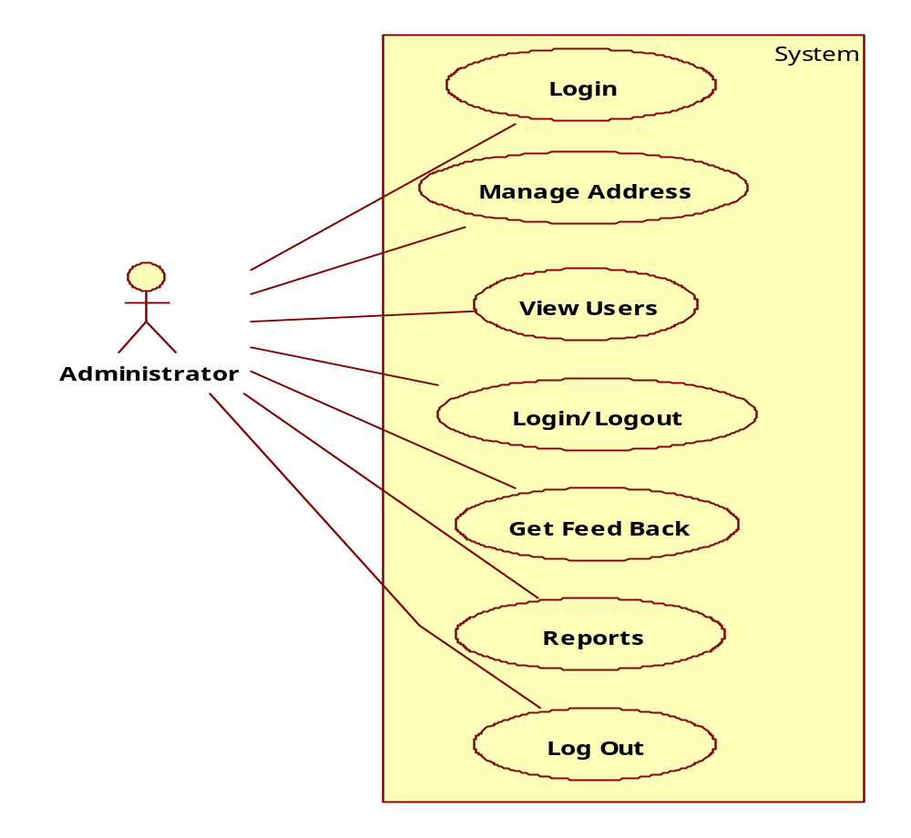
USE CASE DIAGRAMS
ADMIN

Slide 9
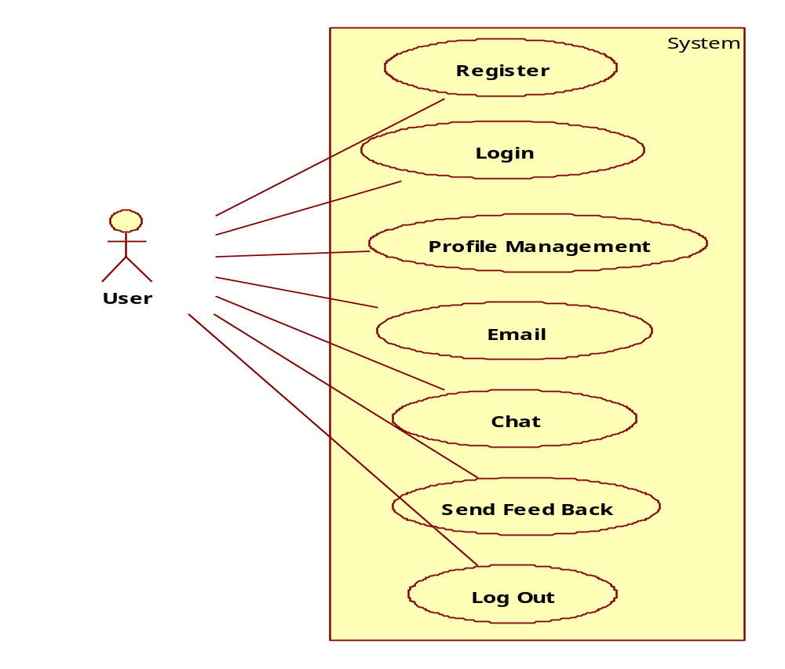
USER ACTIVITIES

Slide 10
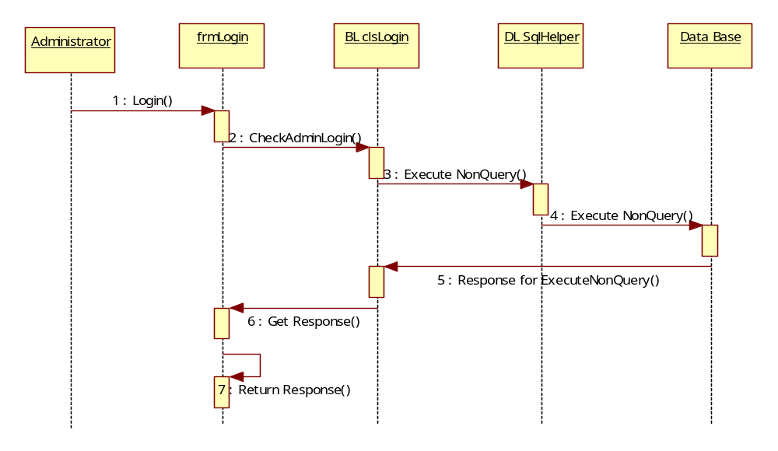
SEQUENCE DIAGRAMS
ADMIN LOGIN

Slide 11
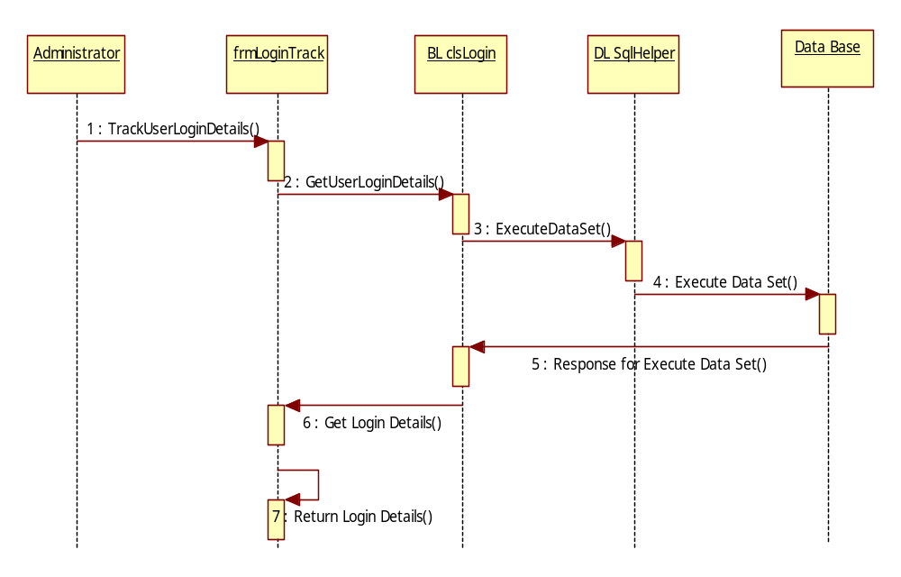
ADMIN TRACK USER LOGIN DETAILS

Slide 12
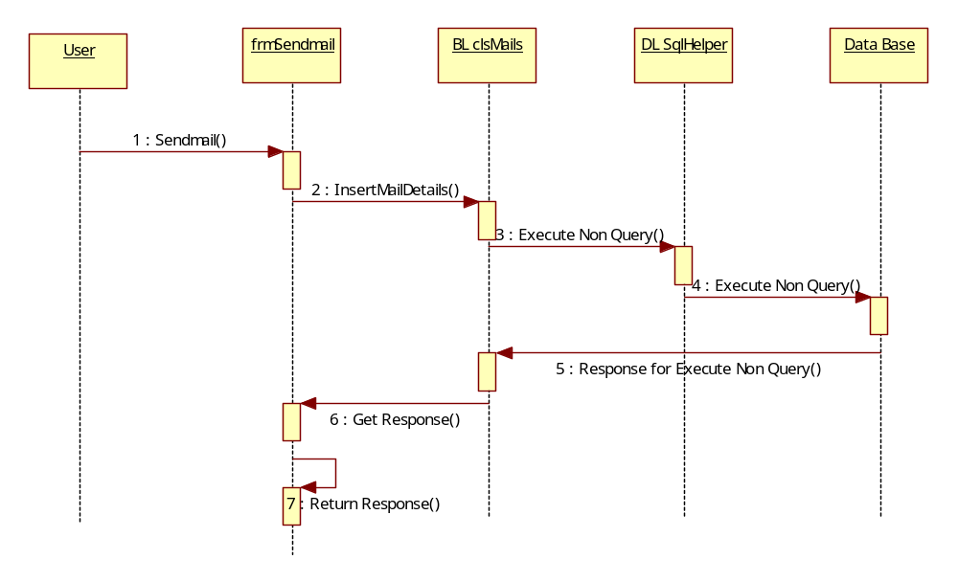
USER ACTIVITIES

Slide 13
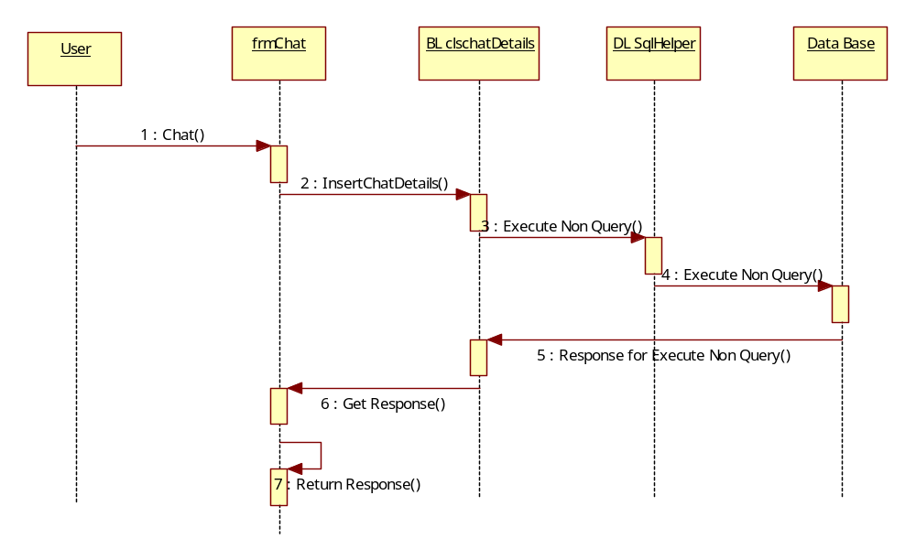
USER CHAT DETAILS

Slide 14
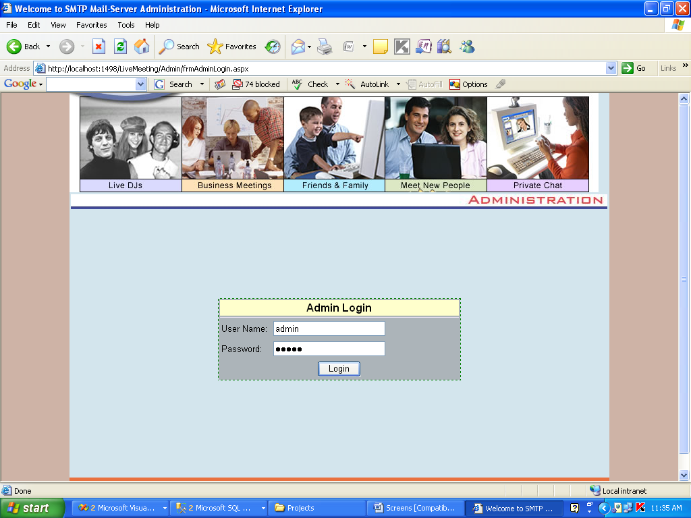
ADMIN AUTHENTICATION

Slide 15
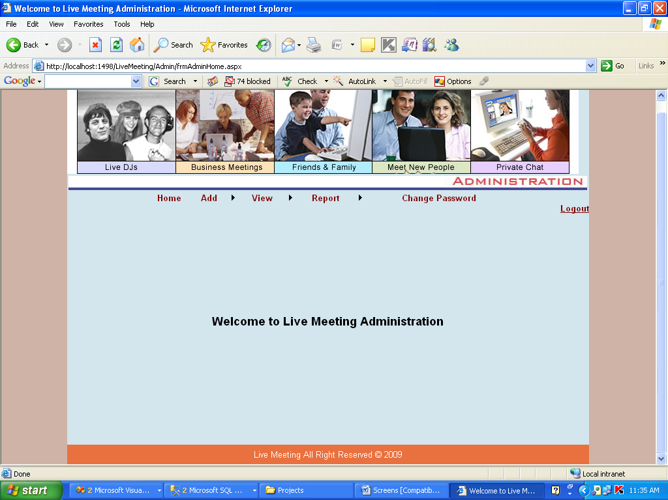
ADMIN HOMEPAGE

Slide 16
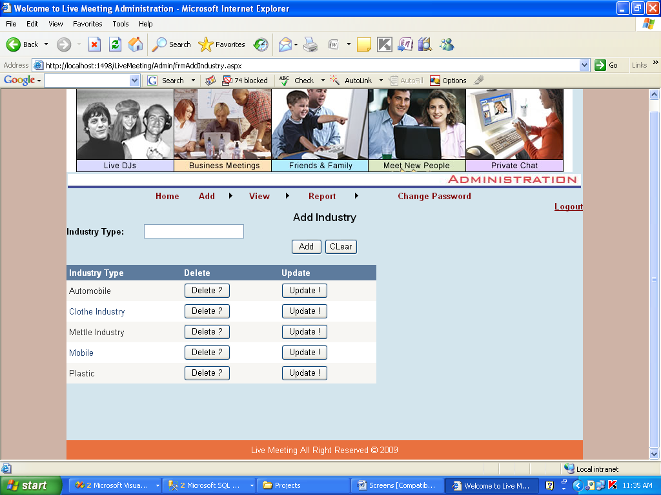
ADDING INDUSTRIES

Slide 17
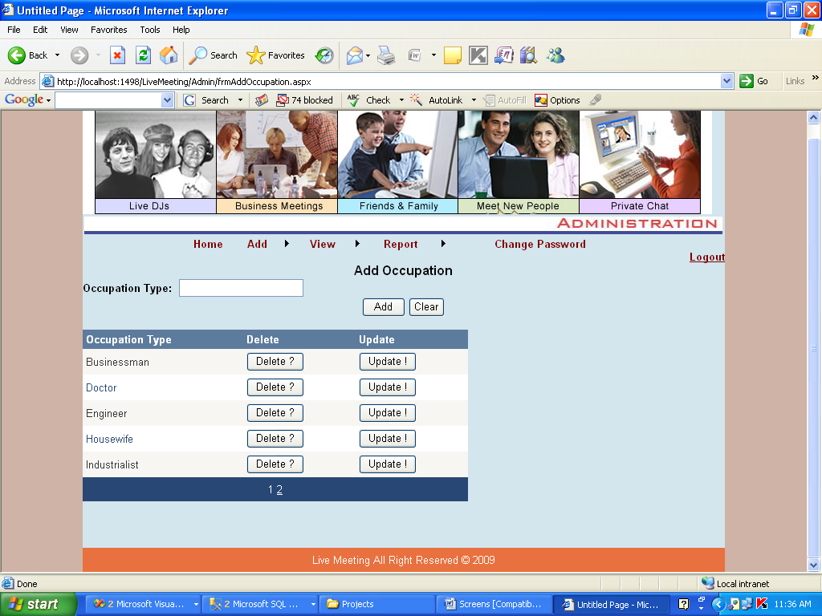
ADDING OCCUPATION

Slide 18
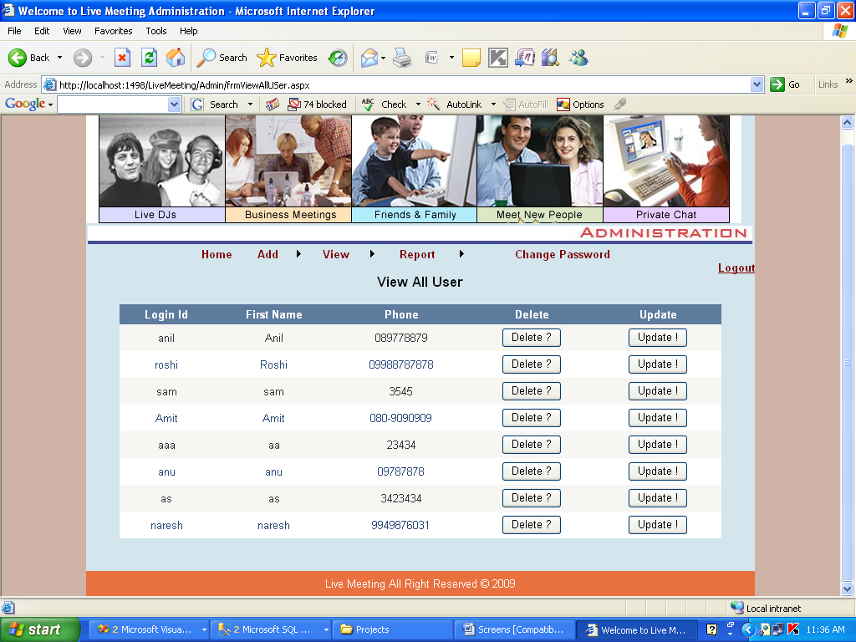
USERS INFORMATION

Slide 19
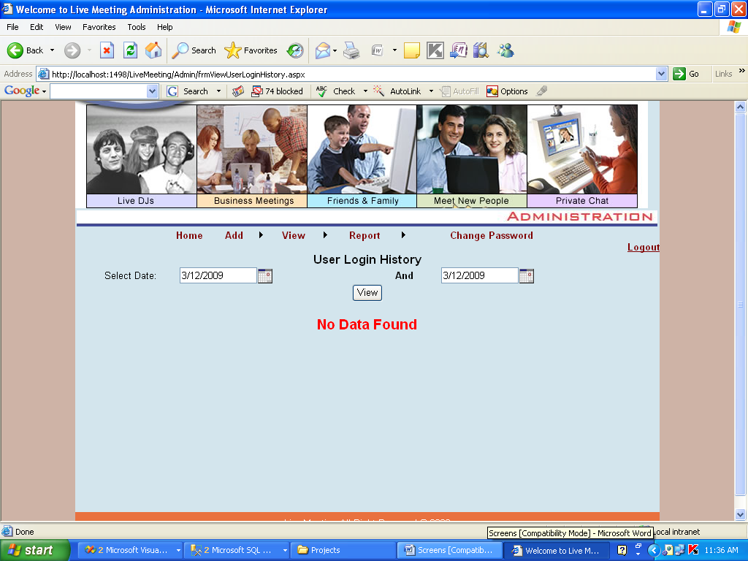
USERS LOGIN HISTORY

Slide 20
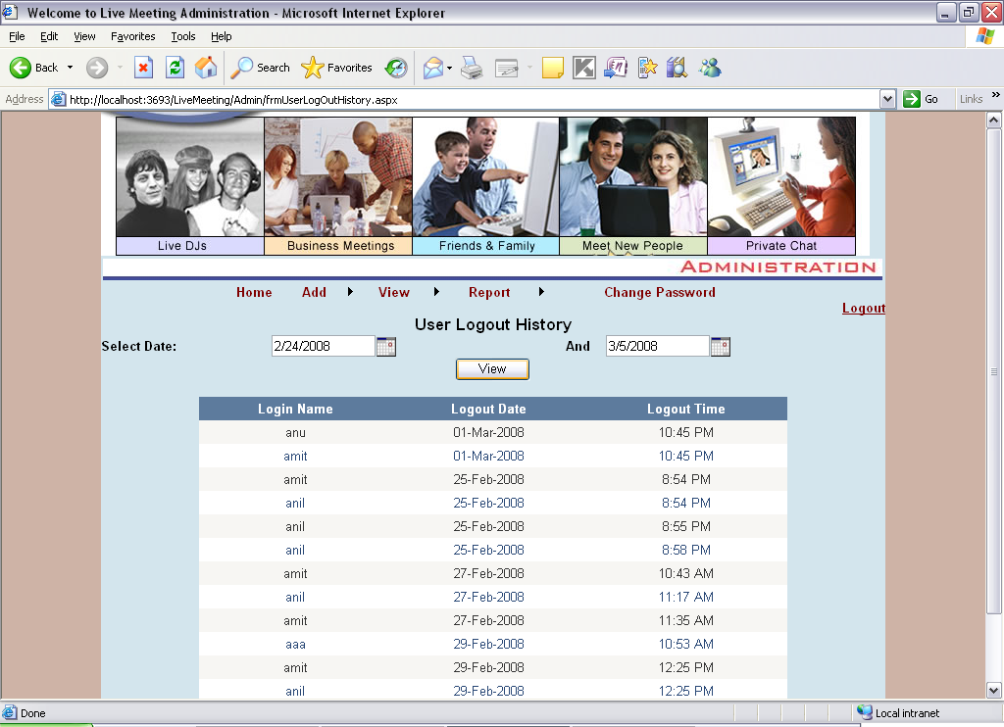
USERS LOGOUT HISTORY

Slide 21
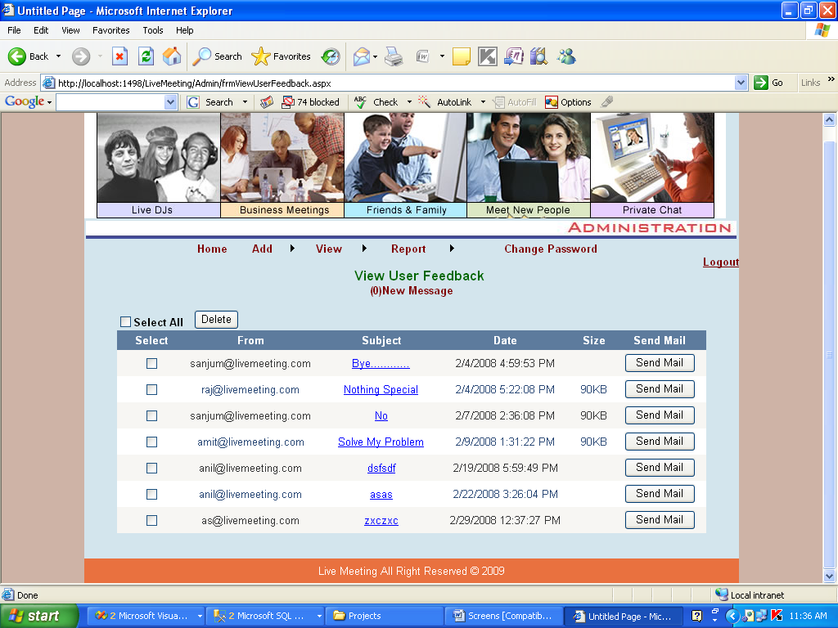
USERS FEEDBACK

Slide 22
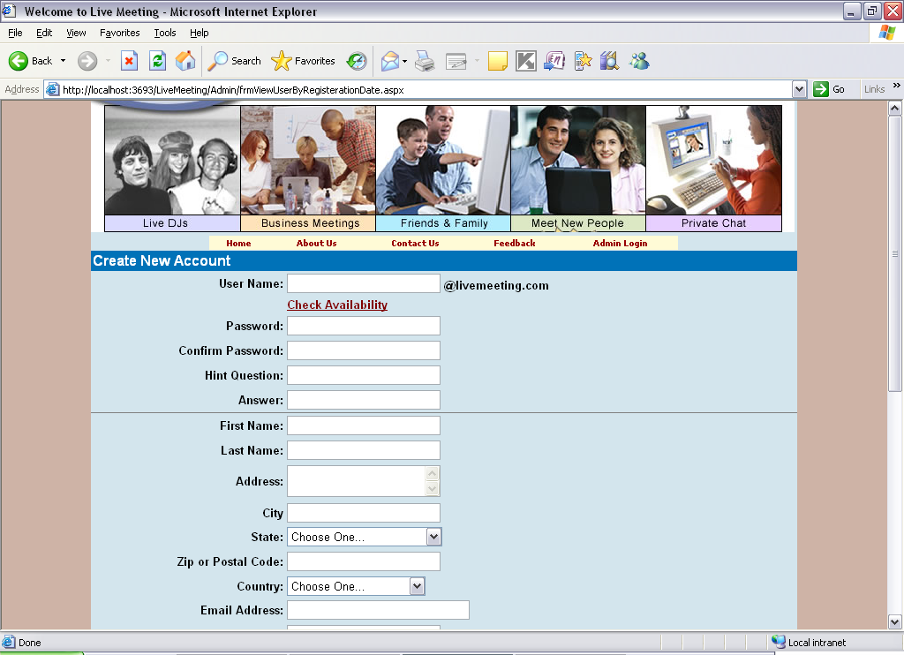
NEW USER REGISTRATION

Slide 23
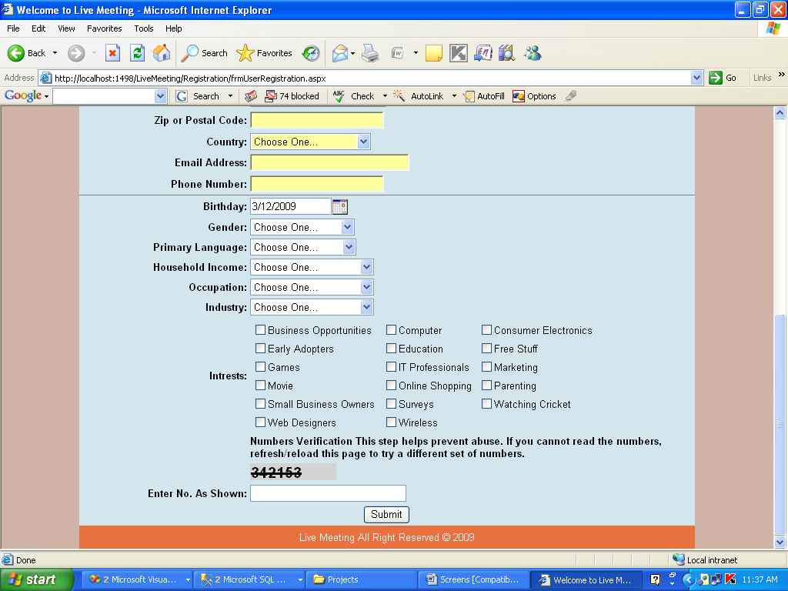

Slide 24
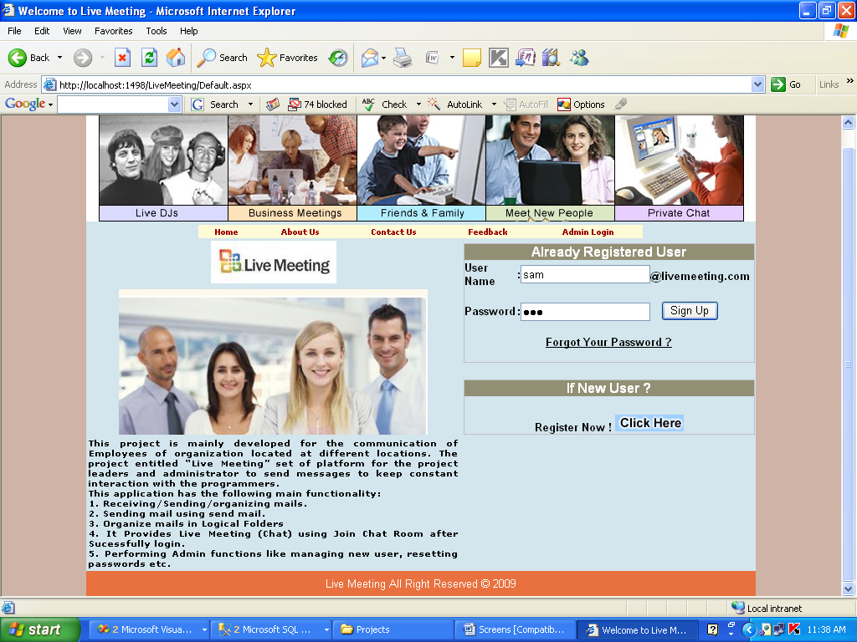
USER LOGIN

Slide 25
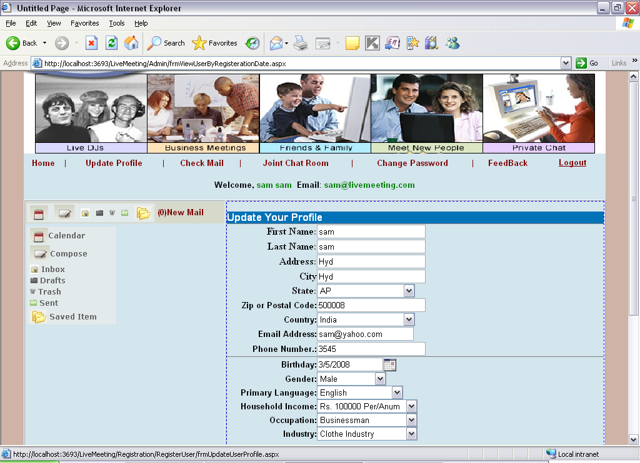
USER HOME PAGE

Slide 26
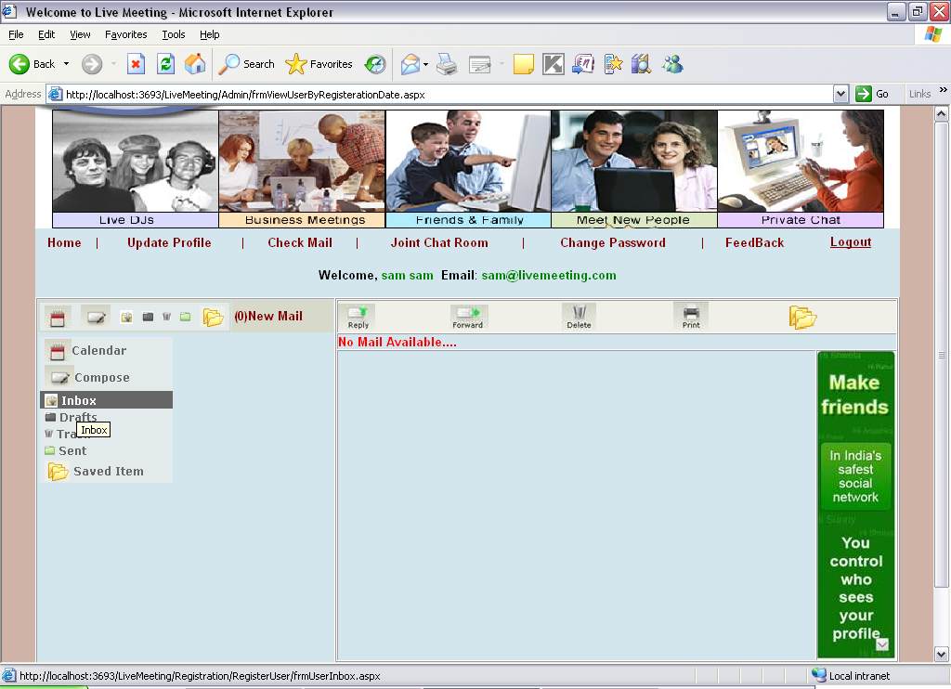
USER CHECKING MAILS

Slide 27
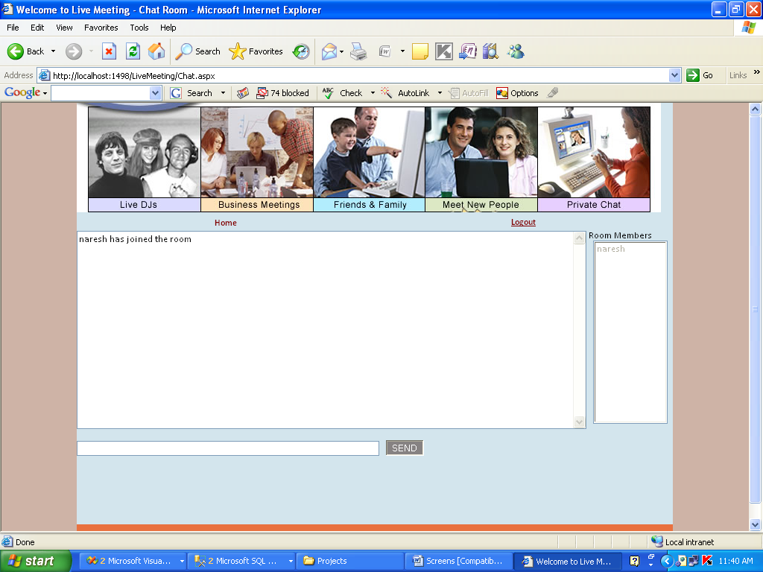
CHATING

Slide 28
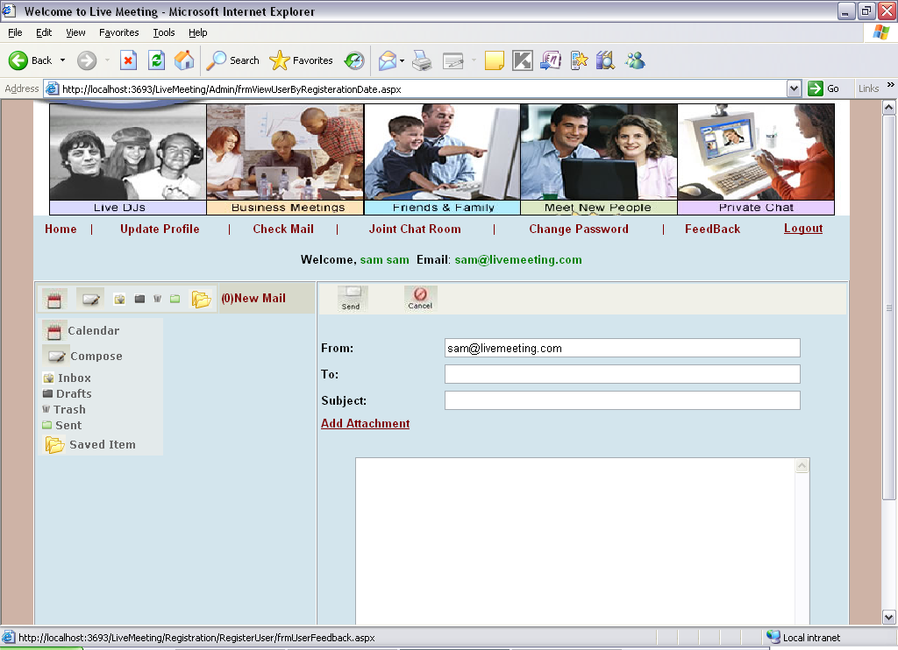
USER SENDING MAILS

Slide 29
CONCLUSION
It’s a web-enabled project.
This is very helpful for the client to enter the desired information through so much simplicity.
The user is mainly more concerned about the validity of the data.
There are options for ADMIN by which he can update the records.
user is provided with the links through framing so that he can go from one option of the project to other.
Data storage and retrieval will become faster and easier to maintain because data is stored in a systematic manner and in a single database.
Decision making process would be greatly enhanced because of faster processing of information.
Through these features it will increase the efficiency, accuracy and transparency.

Slide 30
THANK YOU
BY SWAROOPA

